Slide 1
Elliptic Curve Cryptography

Slide 2
Elliptic Curve Cryptography: Motivation
Public key cryptographic algorithms (asymmetric key algorithms) play an important role in providing security services:
Key management
Confidentiality
User authentication
Signature
Public key cryptography systems are constructed by relying on the hardness of mathematical problems
RSA: based on the integer factorization problem
DH: based on the discrete logarithm problem
The main problem of conventional public key cryptography systems
key size has to be sufficient large in order to meet the high-level security requirement.
This results in lower speed and consumption of more bandwidth
Solution: Elliptic Curve Cryptography system

Slide 3
Introduction to Elliptic Curves
Lets start with a puzzle…
What is the number of balls that may be piled as a square pyramid and also rearranged into a square array?

Slide 4
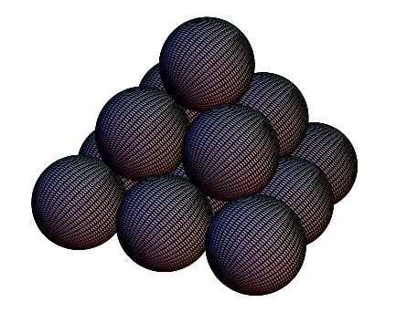
Introduction to Elliptic Curves…
Lets start with a puzzle…
What is the number of balls that may be piled as a square pyramid and also rearranged into a square array?

Slide 5
Introduction to Elliptic Curves…
What about the figure shown?
Does it fulfil our requirements?

Slide 6
Introduction to Elliptic Curves…
What about the figure shown?
Does it fulfil our requirements???
Can you find solutions to this problem???

Slide 7
Introduction to Elliptic Curves…
Let x be the height of the pyramid, then the number of balls in pyramid is,
We also want this to be a square. Hence,

Slide 8
Graphical Representation
Y axis
X axis
Curves of this nature
are called ELLIPTIC
CURVES

Slide 9
Method of Diophantus
Uses a set of known points to produce new points
(0,0) and (1,1) are two trivial solutions
Equation of line through these points is y=x.
Intersecting with the curve and rearranging terms:
What are the roots of this equation???

Slide 10
Method of Diophantus…
Uses a set of known points to produce new points
(0,0) and (1,1) are two trivial solutions
Equation of line through these points is y=x.
Intersecting with the curve and rearranging terms:
What are the roots of this equation???
Two trivial roots x=0 and x=1…… But what about third one????

Slide 11
Method of Diophantus…
We know that, for any numbers a,b,c, we have,
(x-a)(x-b)(x-c) = x³ – (a+b+c)x² + (ab+bc+ac)x – abc
Hence, for the equation
We have,
a+b+x = → 0+1+x = → x=
Hence, one more point (½ , ½) and because of the symmetry , another (½ , -½)

Slide 12
Method of Diophantus… : Exercise
Can you find out another point on curve using Diophantus’s method ???
Consider two points (½ , -½) and (1,1) and find out another point on the curve …..

Slide 13
Method of Diophantus… : Exercise solution
Consider the line through (1/2,-1/2) and (1,1) => y=3x-2
Intersecting with the curve we have:
Thus ½ + 1 + x = 51/2 or x = 24 and y=70
Thus if we have 4900 balls we may arrange them in either way

Slide 14
Weierstrass Equation
For most situations, an elliptic curve E is the graph of an equation of the form:
where A and B are constants. This refers to the Weierstrass Equation of Elliptic Curve.
Here, A, B, x and y all belong to a field of say rational numbers, complex numbers, finite fields (F_{p}) or Galois Fields (GF(2^{n})).
If K is the field where A,B K, then we say that the Elliptic Curve E is defined over K

Slide 15
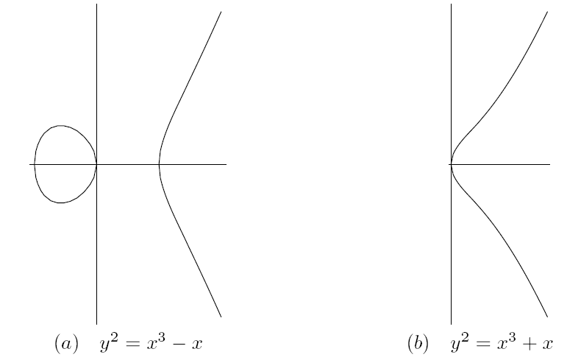
Points on Elliptic Curve
If we want to consider points with coordinates in some field L, we write E(L). By definition, this set always contains the point at infinity O
What about the roots of these curves ????
We must have the equation
4A³ + 27B² ≠0 satisfied
A condition for an Elliptic curve to be a group !!!!!

Slide 16
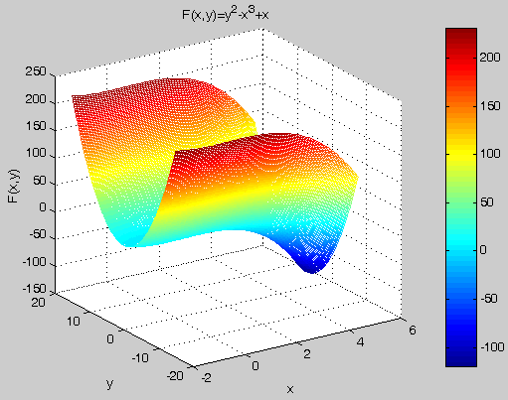
Points on Elliptic Curve…

Slide 17
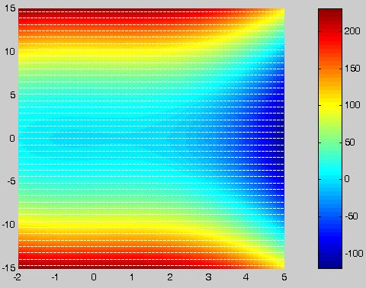
Points on Elliptic Curve…

Slide 18
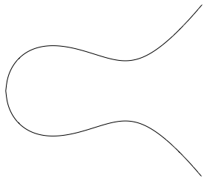
Adding points on Elliptic Curve…
y
Consider elliptic curve
E: y² = x³ - x + 1
Start with two points : P₁(x₁,y₁) and
P₂(x₂,y₂) on elliptic curve
To get a new point P₃ ,
Draw a line L through P₁ and P₂
Get the intersection P₃’
Reflect across x-axis to get P₃
We define P₁ + P₂ = P₃
P₂
P₁
x
P₃

Slide 19
Adding points on Elliptic Curve…
Case 1: P₁ ≠ P₂ and neither point is O
For x₁ ≠ x₂
For x₁ = x₂ ????
We get P₁ + P₂ = O

Slide 20
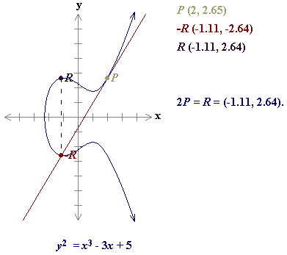
Adding points on Elliptic Curve…
Case II : P₁ = P₂ =(x₁,y₁)
When two points on a curve are very close to each other, the line through them approximates a tangent line. Therefore, when the two points coincide, we take the line L through them to be the tangent line.
Implicit differentiation allows us to find the slope m of L

Slide 21
Adding points on Elliptic Curve…
Case II : P₁ = P₂ =(x₁,y₁)
When two points on a curve are very close to each other, the line through them approximates a tangent line. Therefore, when the two points coincide, we take the line L through them to be the tangent line.
Implicit differentiation allows us to find the slope m of L

Slide 22
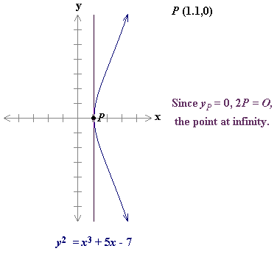
Adding points on Elliptic Curve…
Case II : P₁ = P₂ =(x₁,y₁)
If y₁ = 0
We get P₁ + P₂ = O
Case III: P₂ = O
What about P₁ + P₂ ????
Do we get P₁ + P₂ = P₁ ??
In other words, P₁ + O = P₁

Slide 23
Group Law
The addition of points on an elliptic curve E satisfies the following properties:
(Commutativity) : P₁ + P₂ = P₂ + P₁ for all P₁, P₂ on E
(Existence of identity) : P + O = P for all P on E
(Existence of inverses) : Given P on E, there exists P’ on E with P + P’ = O. This point P’ will usually be denoted as –P
(Associatively) : (P₁ + P₂)+ P₃ = P₁ + (P₂+ P₃ ) for all P₁, P_{2,} P₃ on E
`
The points on E form an additive abelian group with O as the identity element.

Slide 24
Integer times a point
Let k be a positive integer and let P be a point on an elliptic curve, then
kP denotes P + P + · · · + P (with k summands)
Efficient computation for large k
Successive doubling method
For example, to compute 19P, we compute
2P, 4P = 2P+2P, 8P = 4P+4P, 16P = 8P+8P, 19P = 16P+2P+P.
But, the only difficulty is....
The size of the coordinates of the points increases very rapidly if we are working over the rational numbers
What about finite fields ????

Slide 25
Elliptic curves in cryptography

Slide 26
Elliptic curves in Cryptography
Elliptic Curve (EC) systems as applied to cryptography were first proposed in 1985 independently by Neal Koblitz and Victor Miller.
The discrete logarithm problem on elliptic curve groups
More difficult than the corresponding problem in (the multiplicative group of nonzero elements of) the underlying finite field.

Slide 27
Why finite field?
Elliptic curves over real numbers
Calculations prove to be slow
Inaccurate due to rounding error
Infinite field
Cryptographic schemes need fast and accurate arithmetic
In the cryptographic schemes, elliptic curves over two finite fields are mostly used.
Prime field F_{p} , where p is a prime.
Binary field F₂^{m}, where m is a positive integer

Slide 28
Elliptic Curve over finite field F₂₃
As a very small example, consider an elliptic curve over the field F₂₃. With A = 1 and B = 0, the elliptic curve equation is y² = x³ + x.
The point (9,5) satisfies this equation since: y² mod p = x³ + x mod p
25 mod 23 = 729 + 9 mod 23 25 mod 23 = 738 mod 23 2 = 2
The 23 points which satisfy this equation are:
(0,0) (1,5) (1,18) (9,5) (9,18) (11,10) (11,13) (13,5) (13,18) (15,3) (15,20) (16,8) (16,15) (17,10) (17,13) (18,10) (18,13) (19,1) (19,22) (20,4) (20,19) (21,6) (21,17)

Slide 29
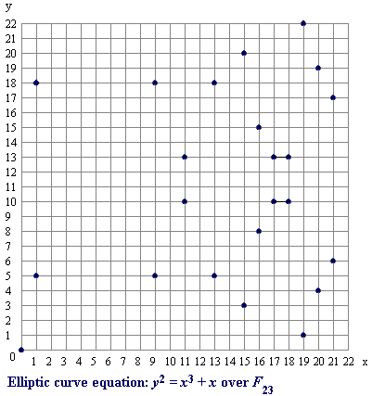
Elliptic Curve over finite field F₂₃…

Slide 30
Elliptic curves over finite fields
Let us do an exercise....
Let E be the curve y² = x³+x+1 over F₅, find all the points on E
x | x³+x+1 | y | Points
0 | 1 | ±1 | (0,1),(0,4)
1 | 3 | - | -
2 | 1 | ±1 | (2,1),(2,4)
3 | 1 | ±1 | (3,1),(3,4)
4 | 4 | ±2 | (4,2),(4,3)
O |  | O | O
Therefore, E(F₅) has order 9.
Can you show that E(F₅) is cyclic??? What is the generator??

Slide 31
Elliptic curves over finite fields… : Exercise
Let E be the curve y² = x³+2 over F₇, find all the points on E
x | x³+2 | y | Points
What is the order of E(F₇) ?
Is E(F₇) cyclic??? If yes, what is the generator??

Slide 32
Elliptic curves over finite fields… : Exercise
Let E be the curve y² +xy = x³ +1 over F₂, find all the points on E
x | x³-xy+1 | y | Points
What is the order of E(F₂) ?
Is E(F₂) cyclic??? If yes, what is the generator??

Slide 33
Discrete logarithms in Finite Fields
F={1,2,3,…,p-1}
Pick secret, random Y from F
Pick secret, random X from F
g^{x} mod p
g^{y} mod p
Alice
Bob
Compute k=(g^{y})^{x}=g^{xy} mod p
Compute k=(g^{x})^{y}=g^{xy} mod p
Eve has to compute g^{xy} from g^{x} and g^{y} without knowing x and y…
She faces the Discrete Logarithm Problem in finite fields

Slide 34
Elliptic Curve Discrete Logarithm Problem (ECDLP)
If we are working over a large finite field and are given points P and kP, it is computationally hard to determine the value of k. This is called the discrete logarithm problem for elliptic curves (ECDLP) and is the basis for the cryptographic applications.

Slide 35
What Is Elliptic Curve Cryptography (ECC)?
Elliptic curve cryptography [ECC] is a public-key cryptosystem just like RSA, El Gamal.
Every user has a public and a private key.
Public key is used for encryption/signature verification.
Private key is used for decryption/signature generation.
Elliptic curves are used as an extension to other current cryptosystems.
Elliptic Curve El-Gamal Encryption
Elliptic Curve Diffie-Hellman Key Exchange
Elliptic Curve Digital Signature Algorithm

Slide 36
Using Elliptic Curves In Cryptography
The central part of any cryptosystem involving elliptic curves is the elliptic group.
All public-key cryptosystems have some underlying mathematical operation.
RSA has exponentiation (raising the message or ciphertext to the public or private values)
ECC has point multiplication (repeated addition of two points).

Slide 37
Discrete Logarithm Key pair generation
A key pair is associated with a set of public domain parameters (p,q, g). Here, p is a prime, q is a prime divisor of p−1, and g ∈ [1, p−1] has order q

Slide 38
ECC Key pair generation
Let E be an elliptic curve defined over a finite field Fp.
Let P be a point in E(Fp), and suppose that P has prime order n. Then the cyclic subgroup of E(Fp) generated by P is,
P = {O, P, 2P, 3P, . . ., (n−1)P}.
The public domain parameters are : The prime p, the equation of the elliptic curve E, and the point P and its order n : (p,E,P,n)
A private key is an integer d that is selected uniformly at random from the interval [1,n −1], and the corresponding public key is Q = dP.

Slide 39
Basic Elgamal encryption scheme
Basic ElGamal Encryption
Basic ElGamal Decryption

Slide 40
ECC Analog to El Gamal : ECEG
EC-ElGamal Encryption
EC-ElGamal Decryption

Slide 41
Diffie-Hellman (DH) Key Exchange

Slide 42
Can you suggest ECC analog to this ?????

Slide 43
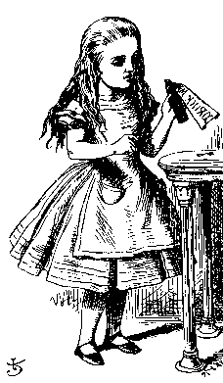
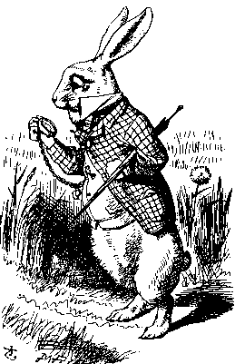
ECC Diffie-Hellman: ECDH
Public: Elliptic curve and point G=(x,y) on curve
Secret: Alice’s A and Bob’s B
A(x,y)
B(x,y)
Alice, A
Bob, B
Alice computes A(B(x,y))
Bob computes B(A(x,y))
These are the same since AB = BA

Slide 44
ECC Diffie-Hellman: ECDH…
Public: Curve y² = x³ + 7x + b (mod 37) and point G=(2,5)
Alice’s secret: A = 4
Bob’s secret: B = 7
Alice sends Bob: 4(2,5) = (7,32)
Bob sends Alice: 7(2,5) = (18,35)
Alice computes: 4(18,35) = (22,1)
Bob computes: 7(7,32) = (22,1)

Slide 45
Digital Signature Algorithm (DSA)
Signature Generation
Signature Verification

Slide 46
ECC analogue to DSA : ECDSA
Signature Generation
Signature Verification

Slide 47
Why use ECC?
Criteria to be considered while selecting PKC for application
Functionality: Does the public-key family provide the desired capabilities?
Security: What assurances are available that the protocols are secure?
Performance: For the desired level of security, do the protocols meet performance objectives?
Also some misc. factors such as existence of best-practice standards developed by accredited standards organizations, the availability of commercial cryptographic products, and patent coverage.

Slide 48
Why use ECC?...
The RSA, DL and EC families all provide the basic functionality expected of public-key cryptography
But…… How do we analyze these Cryptosystems?
How difficult is the underlying problem that it is based upon
RSA – Integer Factorization
DH – Discrete Logarithms
ECC - Elliptic Curve Discrete Logarithm problem

Slide 49
Why use ECC?…
How do we measure difficulty?
We examine the algorithms used to solve these problems
Integer factorization
Number Field Sieve (NFS) : Sub exponential running time
Discrete Logarithm
Number Field Sieve (NFS) : Sub exponential running time
Pollard’s rho algorithm
Elliptic Curve Discrete Logarithm Problem(ECDLP)
Pollard’s rho algorithm : Fully exponential running time

Slide 50
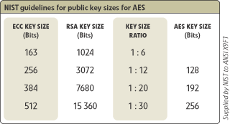
Why use ECC?...
To protect a 128 bit AES key it would take a:
RSA Key Size: 3072 bits
ECC Key Size: 256 bits
How do we strengthen RSA?
Increase the key length
Impractical?

Slide 51
Applications of ECC
Many devices are small and have limited storage and computational power
Where can we apply ECC?
Wireless communication devices
Smart cards
Web servers that need to handle many encryption sessions
Any application where security is needed but lacks the power, storage and computational power that is necessary for our current cryptosystems

Slide 52
Libraries Supporting ECC
Sr. No. | Library | Remarks
1 | borZoi | It is written in C++ Supports ECDSA, ECIES and ECDH.
2 | Crypto++ | C++ library supporting ECDSA, ECDH and ECIES. It supports both binary and prime curves.
3 | LibTomCrypt | It supports only ECDSA and ECDH not ECIES. It supports only curves defined over prime fields. It has nice interface and documentation.
4 | LiDIA | It is free for noncommercial use. It supports curves defined over binary and prime fields. In this library points can be represented in either affine or projective coordinates.
5 | MIRACL | It is also free for nonprofit purposes. It also supports curves defined over prime and binary curves. It is the fastest library and it also supports pre computation.
52

Slide 53
Libraries Supporting ECC…
Sr. No. | Library | Remarks
6 | OpenSSL | open-source written in C. It supports ECDSA and ECDH. It has very poor documentation.
7 | Bouncy Castle | It supports ECDSA, ECDH and ECIES. It provides supports only for curves defined over prime fields, although the documentation refers to binary curves also. It does not support pre computation.
8 | FlexiProvider | It supports ECDSA, ECNR, ECIES and also ECDH. It also supports curves defined over binary and prime fields. It does not provide and support for pre computation.
9 | IAIK | It is available under educational, commercial or open source licenses. It supports ECDSA and ECDH. It can handle curves defined over binary and prime fields. It provides pre computation for prime curves.
53

Slide 54
Libraries Supporting ECC…
Sr. No. | Library | Remarks
10 | Libecc | Libecc is an elliptic curve crypto library for C++ developers. It is currently under development.
11 | ECC-LIB | fully-equipped, portable, and modular library for Elliptic Curve (EC) Cryptography The library is implemented in ANSI C.
12 | PBC Library | The PBC (Pairing based cryptography) library is a free C library Performs the mathematical operations underlying pairing-based cryptosystems.
54

Slide 55
Tutorial questions

Slide 56
Tutorial I : Elliptic curves over real numbers
1. Does the elliptic curve equation y² = x³ - 7x - 6 over real numbers define a group?
2. What is the additive identity of regular integers?
3. Is (4,7) a point on the elliptic curve y² = x³ - 5x + 5 over real numbers?
4. What are the negatives of the following elliptic curve points over real numbers? P(-4,-6), Q(17,0), R(3,9), S(0,-4)
5. In the elliptic curve group defined by y² = x³ - 17x + 16 over real numbers, what is P + Q if P = (0,-4) and Q = (1,0)?
6. In the elliptic curve group defined by y² = x³ - 17x + 16 over real numbers, what is 2P if P = (4, 3.464)?

Slide 57
Tutorial I : Solution
1. Does the elliptic curve equation y² = x³ - 7x - 6 over real numbers define a group?
Ans: Yes
2. What is the additive identity of regular integers?
Ans: 0
3. Is (4,7) a point on the elliptic curve y² = x³ - 5x + 5 over real numbers?
Ans: Yes
4. What are the negatives of the following elliptic curve points over real numbers? P(-4,-6), Q(17,0), R(3,9), S(0,-4)
Ans: -P(-4,6), -Q(17,0), -R(3,-9), -S(0,4)
5. In the elliptic curve group defined by y² = x³ - 17x + 16 over real numbers, what is P + Q if P = (0,-4) and Q = (1,0)?
Ans: P + Q = (15, -56)
6. In the elliptic curve group defined by y² = x³ - 17x + 16 over real numbers, what is 2P if P = (4, 3.464)?
Ans: 2P = (12.022, -39.362)

Slide 58
Tutorial II : Elliptic curves over real numbers
Consider the curve y² = x³ + 5x -7
Answer the following for the above curve :
Does the curve form group ?
Consider the point P(1.1, 0) on curve. Find the points 2P, 3P, 4P, 5P, 6P and 7P on curve.

Slide 59
Tutorial II : Solution
Consider the curve y² = x³ + 5x -7
Ans:
Yes
2P = O, 3P,=P, 4P= O, 5P,=P, 6P= O and 7P=P

Slide 60
Tutorial III : Elliptic Curves over finite fields
1. Let E be the curve y² = x³+x+1 over F₅,
→ Find all the points on E
→ What is the order of E(F₅) ?
→ Show that E(F₅) is cyclic with (0,1) as generator point
2. Let E be the curve y² = x³+2 over F₇,
→Find all the points on E
→ What is the order of E(F₅) ?
→ Is E(F₇) cyclic ?

Slide 61
Tutorial III : Solution
1. Let E be the curve y² = x³+x+1 over F₅,
→ Find all the points on E
→ What is the order of E(F₅) ?
→ Show that E(F₅) is cyclic with (0,1) as
generator point
Ans: The order of E is 9. E(F₅) is cyclic with (0,1) as generator point
x | x³+x+1 | y | Points
0 | 1 | ±1 | (0,1),(0,4)
1 | 3 | - | -
2 | 1 | ±1 | (2,1),(2,4)
3 | 1 | ±1 | (3,1),(3,4)
4 | 4 | ±2 | (4,2),(4,3)
∞ |  | ∞ | ∞

Slide 62
Tutorial IV : Elliptic curve over finite fields
1. Does the elliptic curve equation y² = x³ + 10x + 5 define a group over F₁₇?
2. Do the points P(2,0) and Q(6,3) lie on the elliptic curve y² = x³ + x + 7 over F₁₇?
3. What are the negatives of the following elliptic curve points over F₁₇?
P(5,8) Q(3,0) R(0,6)
4. In the elliptic curve group defined by y² = x³ + x + 7 over F₁₇, what is P + Q if P = (2,0) and Q = (1,3)?
5. In the elliptic curve group defined by y² = x³ + x + 7 over F₁₇,
what is 2P if P = (1, 3)?

Slide 63
Tutorial IV : Solution
1. Does the elliptic curve equation y² = x³ + 10x + 5 define a group over F₁₇?
Ans: No
2. Do the points P(2,0) and Q(6,3) lie on the elliptic curve y² = x³ + x + 7 over F₁₇?
Ans: P lies, Q doesn’t lie on elliptic curve
3. What are the negatives of the following elliptic curve points over F₁₇?
P(5,8) Q(3,0) R(0,6)
Ans: -P(5,9), -Q(3,0), -R(0,11)
4. In the elliptic curve group defined by y² = x³ + x + 7 over F₁₇, what is P + Q if P = (2,0) and Q = (1,3)?
Ans : P + Q = (6,12)
5. In the elliptic curve group defined by y² = x³ + x + 7 over F₁₇, what is 2P if P = (1, 3)?
Ans: 2P = (6,5)

Slide 64
key references
Elliptic Curves: Number Theory and Cryptography, by Lawrence C. Washington
Guide to Elliptic Curve Cryptography, Alfred J. Menezes
Guide to Elliptic Curve Cryptography, Darrel R. Hankerson, A. Menezes and A. Vanstone
For Tutorials: www.certicom.com

Slide 65
Thank you !! Q&A

